Slide 1

Introduction to Academic Writing

Slide 2
Academic Writing
Academic writing refers to the kind of speaking and writing which you find in academic subjects of various kinds, e.g. Education, science, business reviews, architecture, philosophy, fine arts, etc.
Evidence based, well reasoned and logically developed arguments
Pieces of writing that are reliable body of knowledge

Slide 3
Different types of academic writings
Argumentative essay/paper
Case study/ dissertation/thesis
Literary criticisms
Seminar and tutorial paper
Group project/ small scale research
Portfolio of learning/ reflective writing

Slide 4
What is expected of the students in further education?
Students need to write in an academic style
Students need to be analytical
Students need to use evidence effectively
Students need to structure their essays logically
Students need to be critical and persuasive

Slide 5
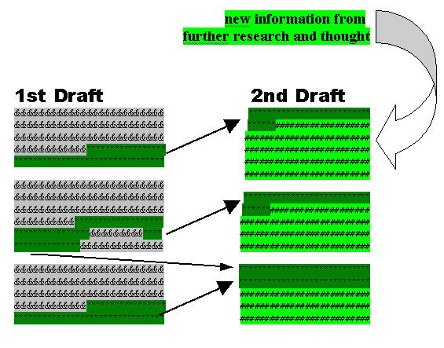

Slide 6
The Writing Process
Brainstorming/researching
Filtering
Planning
Writing (1st draft)
Revisions
Submitting/publishing

Slide 7
Final drafts are never perfect; they simply mark the point when time or motivation ran out. First drafts, on the other hand, are always bad. Indeed, the only good thing about a first draft is that it is necessary before you can write a second draft. Never let this fact depress or discourage you. It should liberate you. To write effectively you should relax and allow the first draft to flow. Do not pay too much attention to organisation or style at this point. Relax and scribble, you will be able to improve it later, but only if you have written it in the first place!

Slide 8
Revision
In terms of
information accuracy
Redundancy
Grammar
Vocabulary choice
Format
Convention

